Slide 1

Raghad Alrefaei| 4112248 | Section L01
Tasneem Mohammad | 4110400 | Section L06
Khadija Mohammad | 4111576 | Section L06
Lama Mohammed | 4210682 | Section L06

Slide 2

Privacy is a hard thing to maintain in our modern technology days. And cryptography is one way to solve this problem.
We use it to safeguard personal identifiable information (PII) and other confidential data

Slide 3

The sections for the program :
Get the message from the user
Encrypt
the massage
Decrypt
the massage

Slide 4
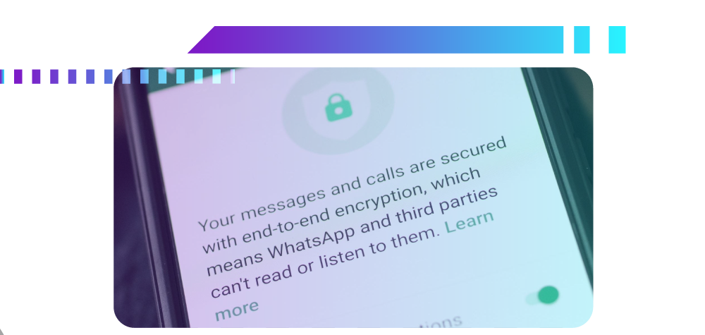
Why we use secrets
messages (cryptography) ?

Slide 5

The Difficulties We Encountered in the Project:
1- In writing the code.
2- In grouping the code together.
3- The project requires so many objectives so that's
makes hard to included in one idea.
4- Converting our code to the GUI.
5- Manage our short time to be the project done.

Slide 6
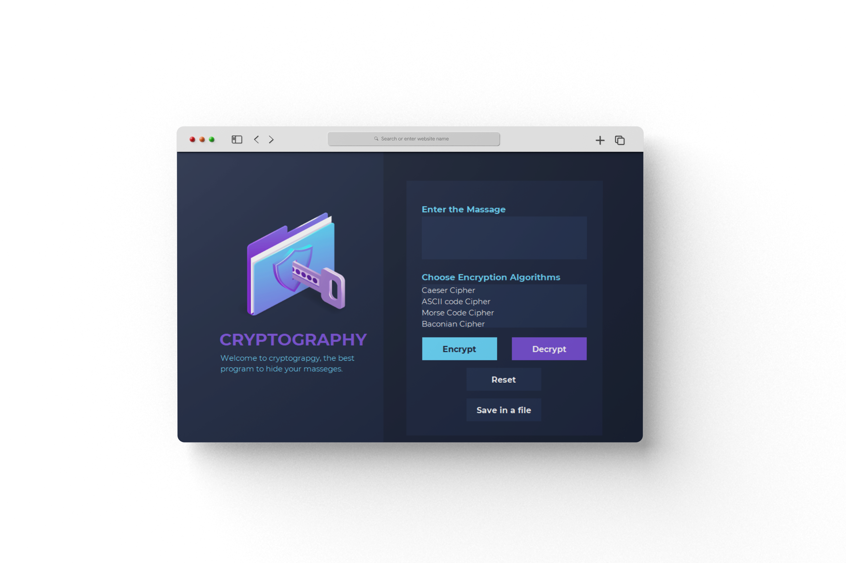
I will show you running the project:
This is a project interface , through this interface you can enter your message, choose the algorithm from the list box, encrypt or decrypt
button for clear everything and another to save your message in a file !

Slide 7
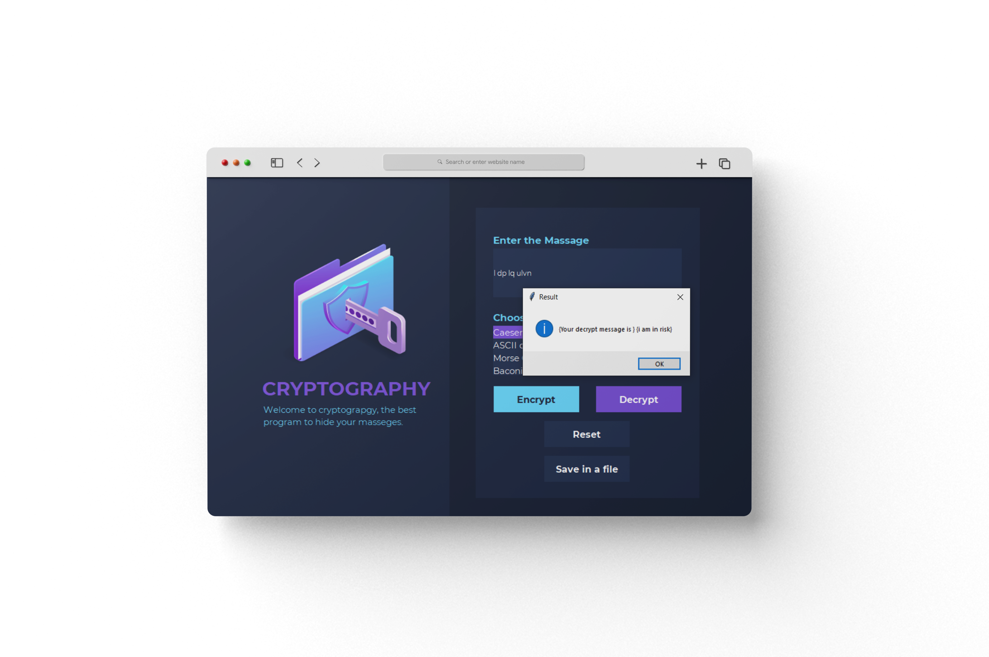
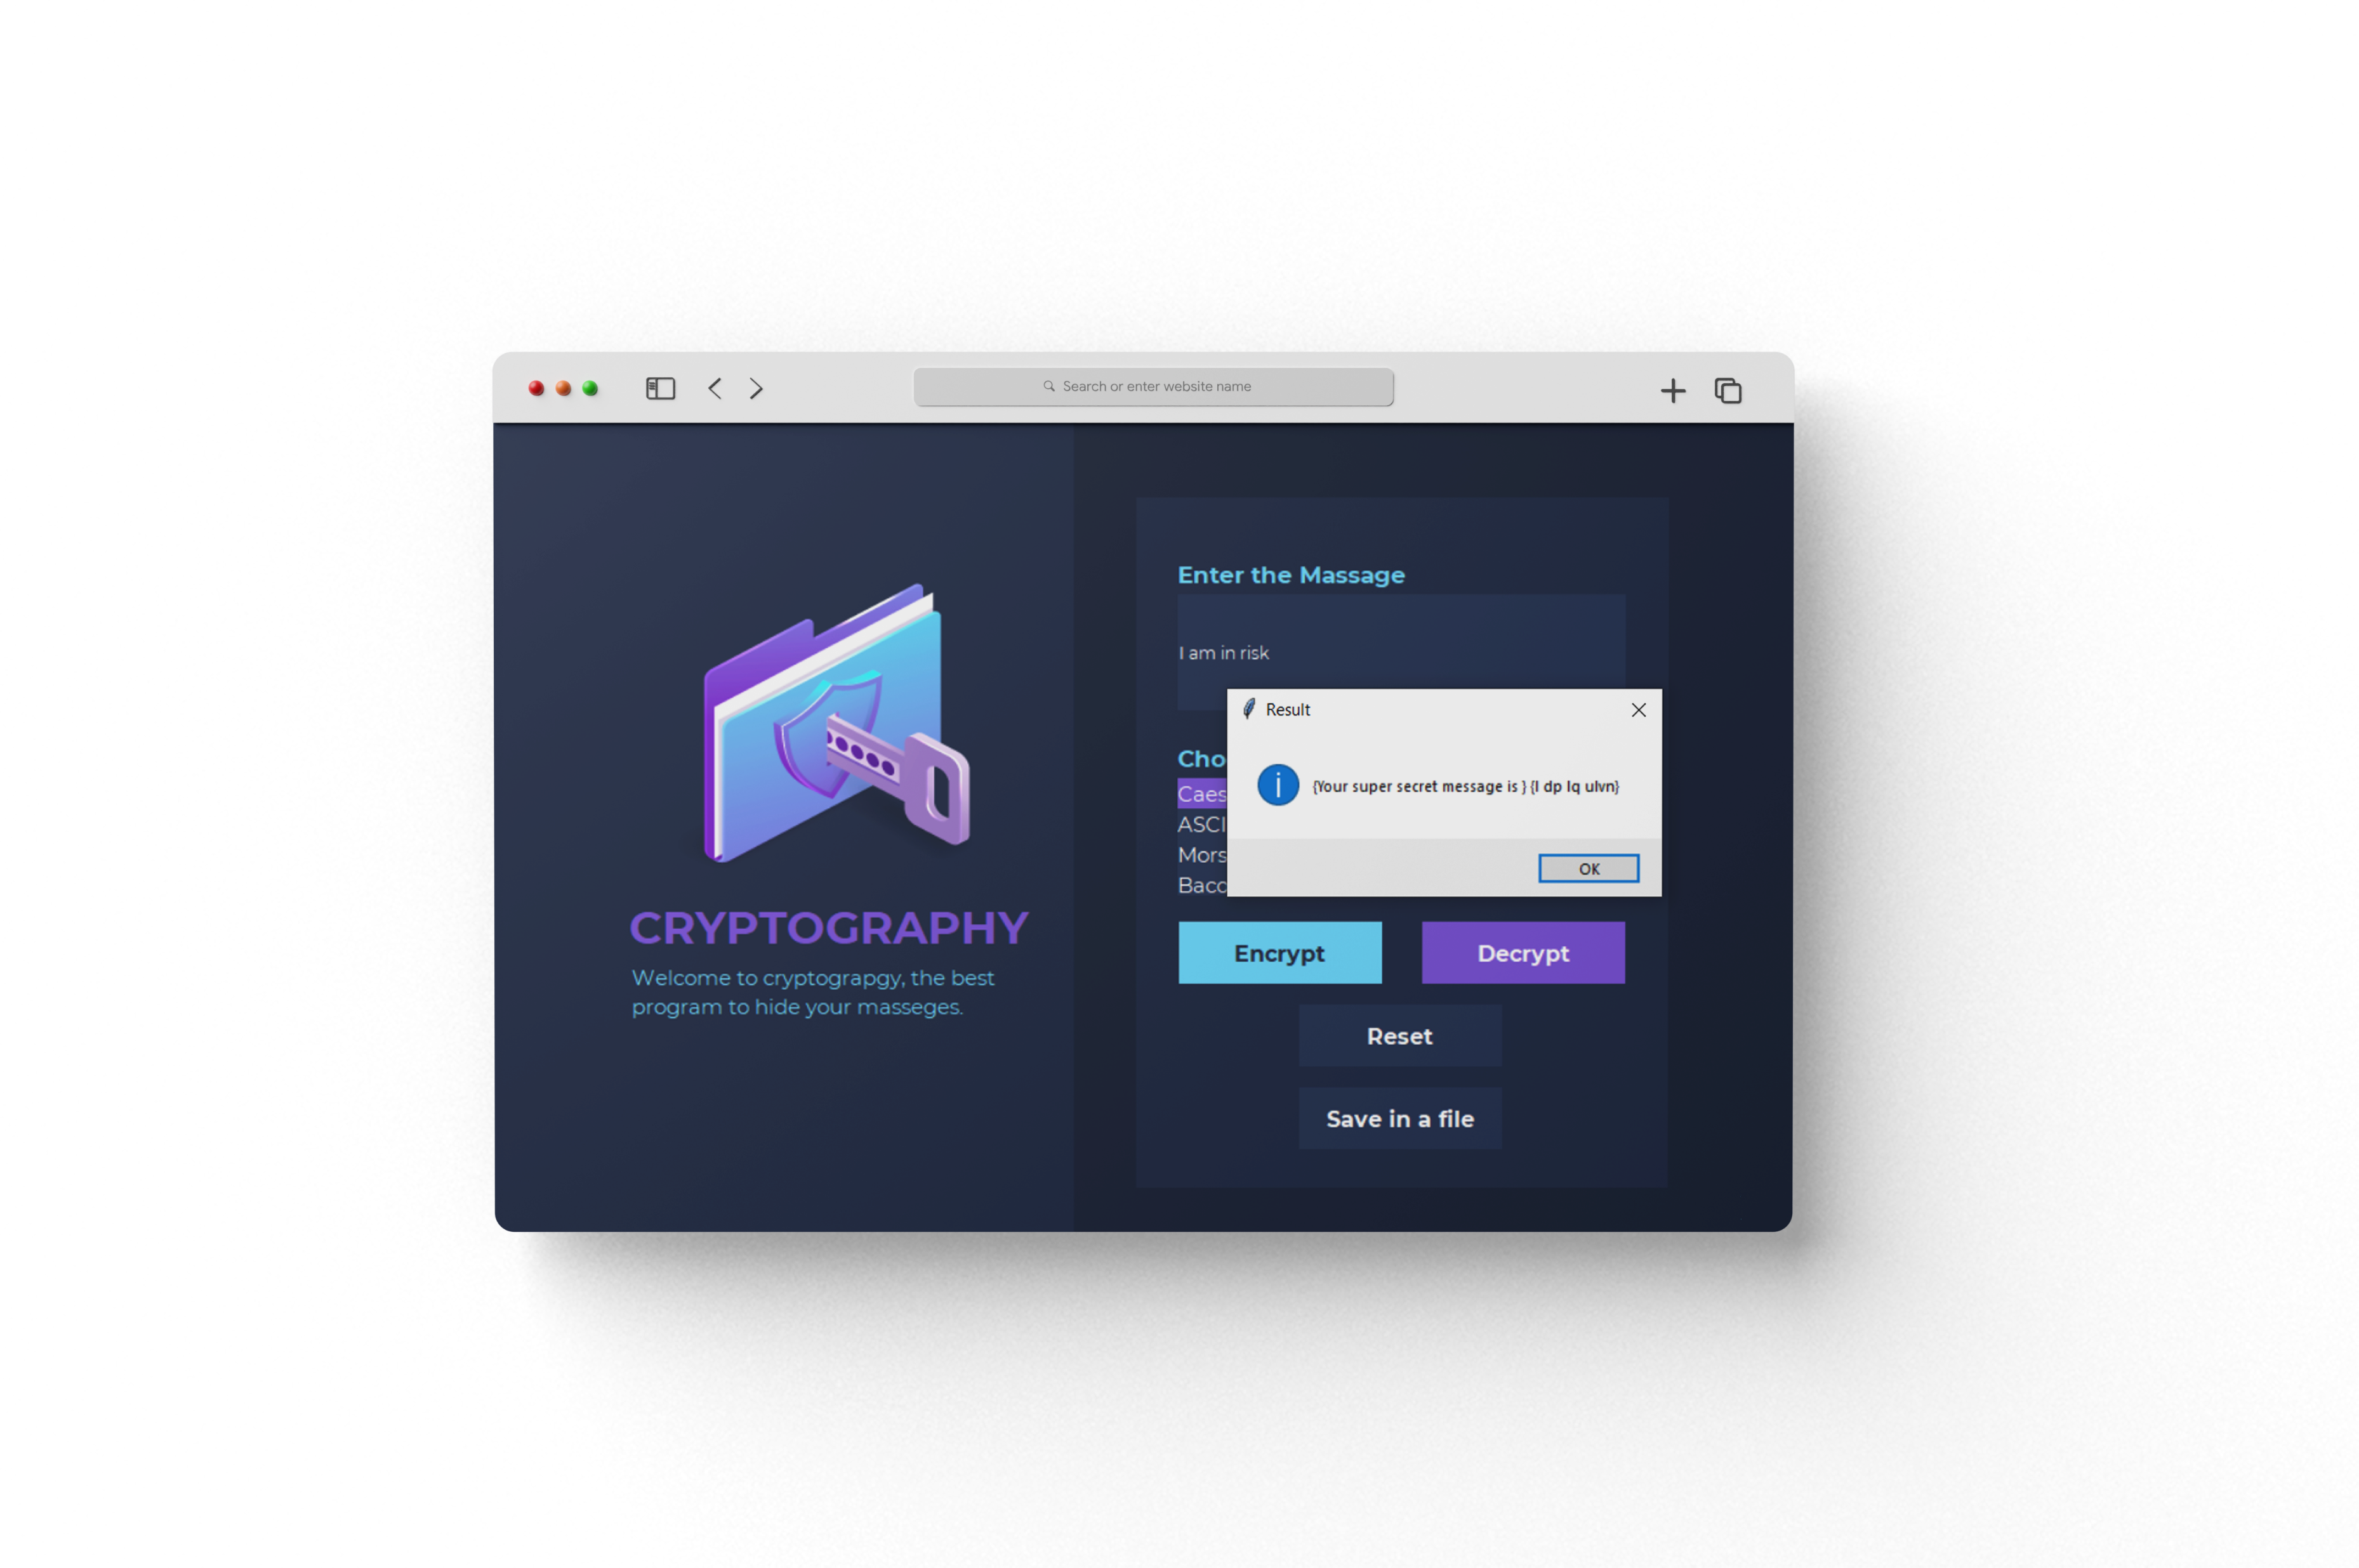
Encryption and Decryption

Slide 8
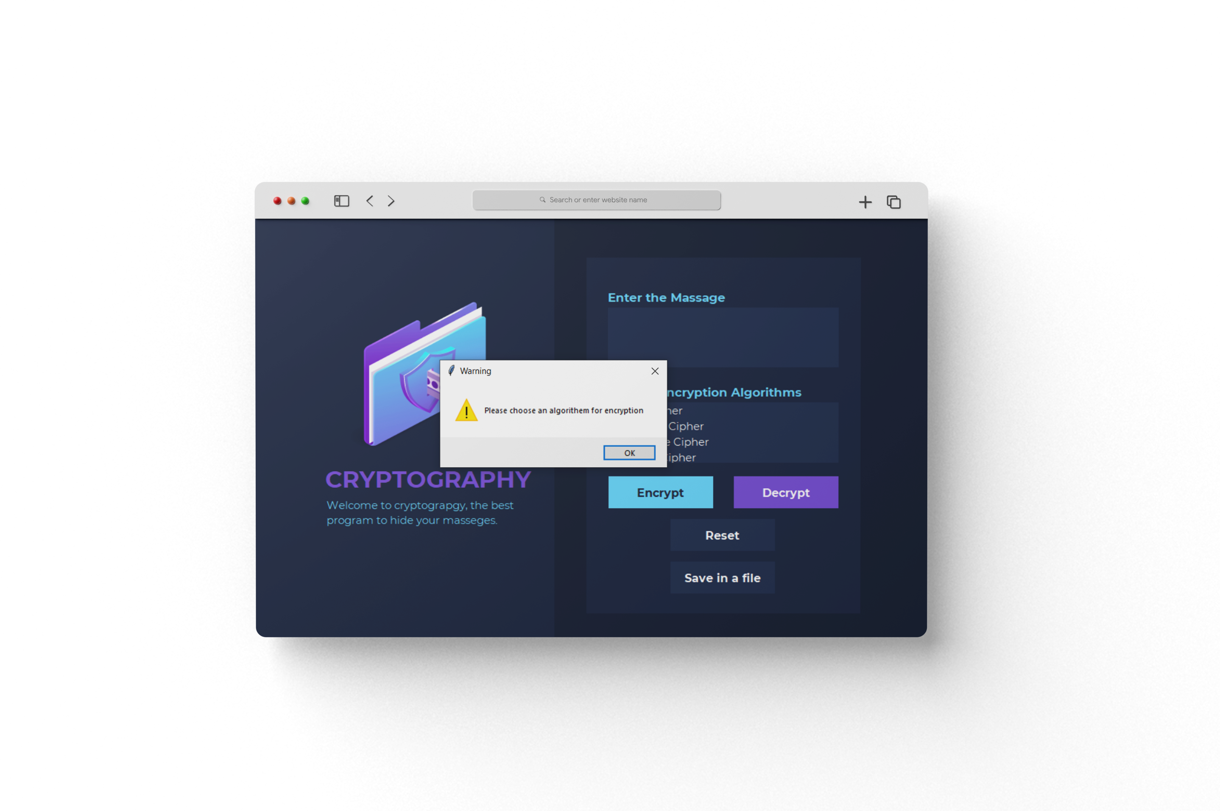
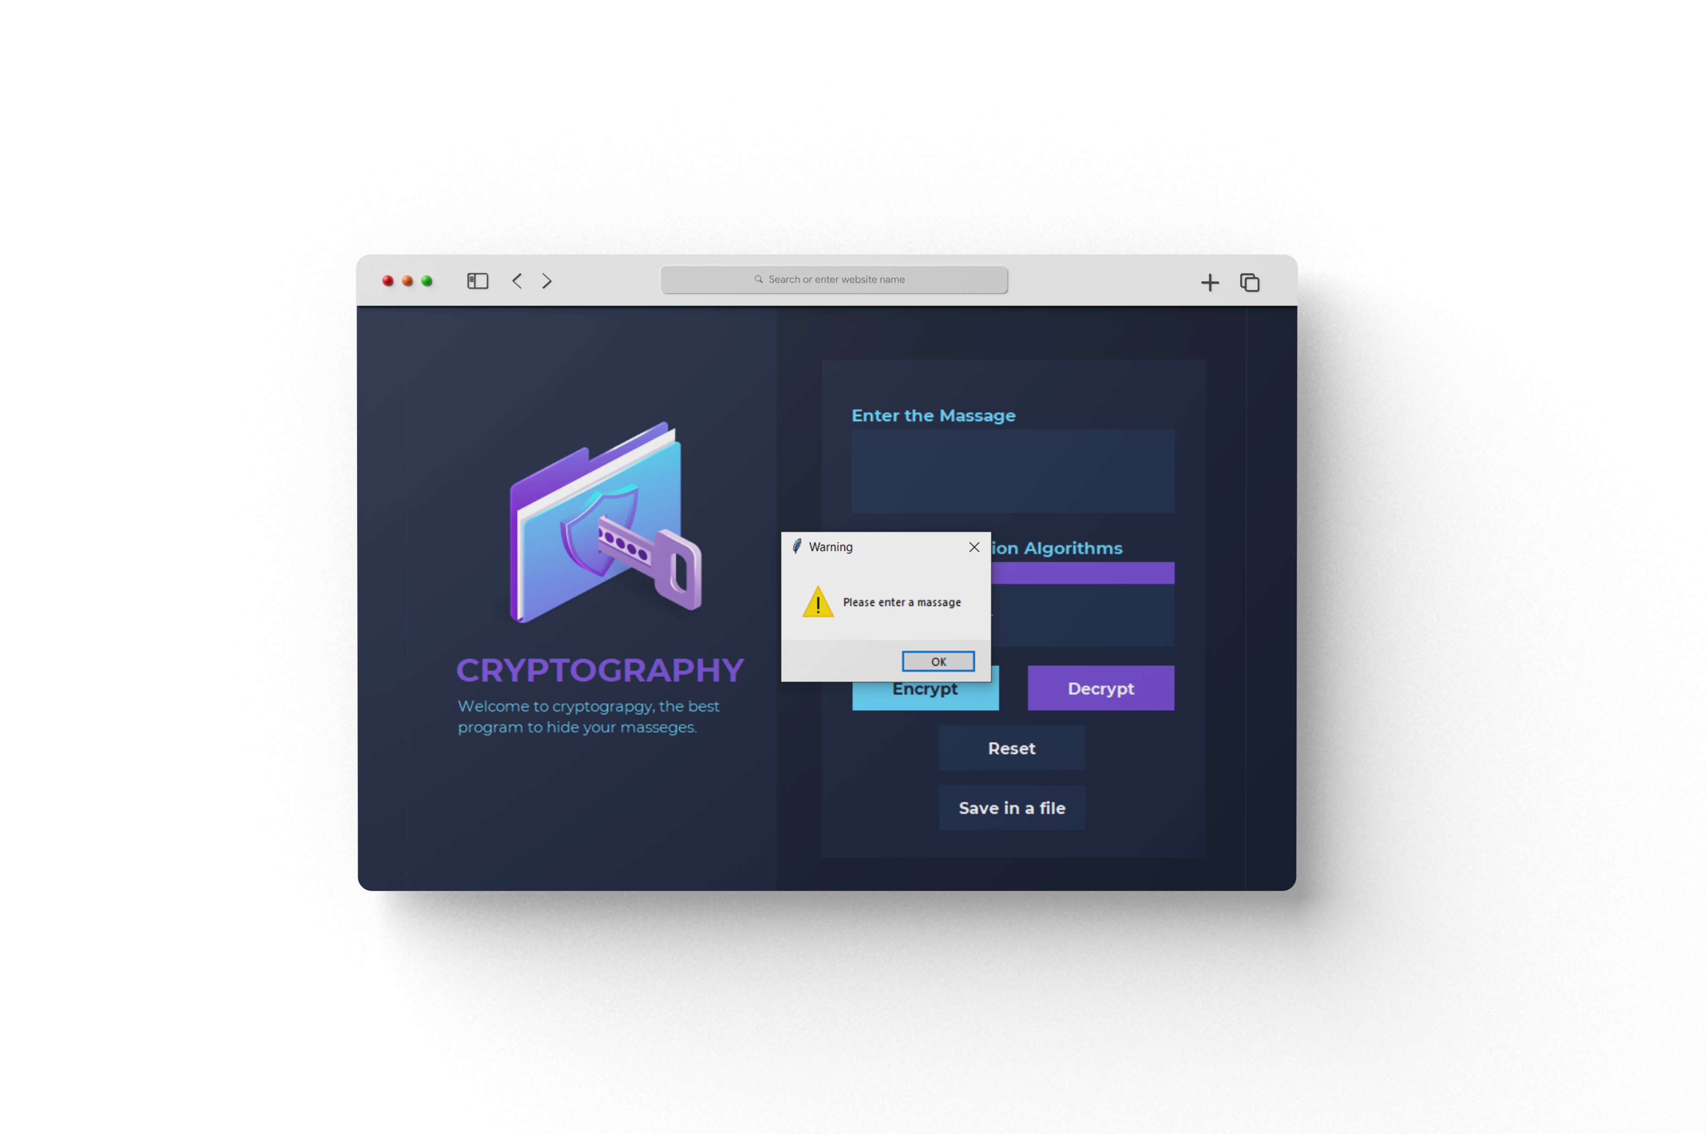
Catching Errors

Slide 9
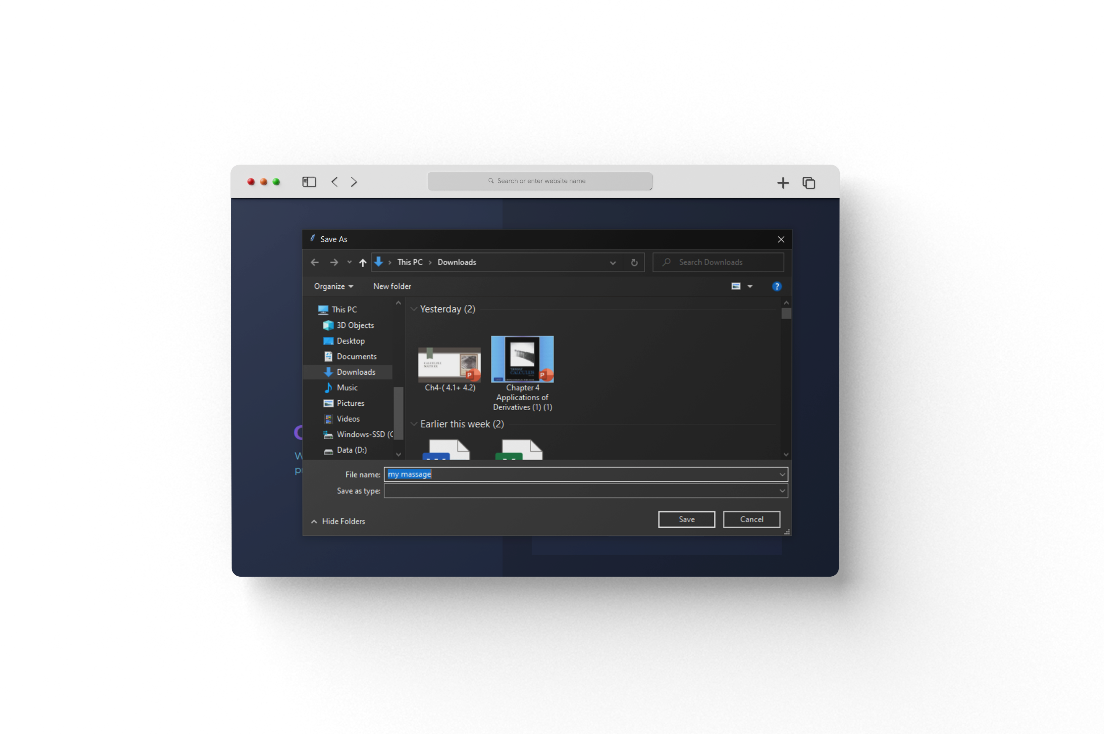
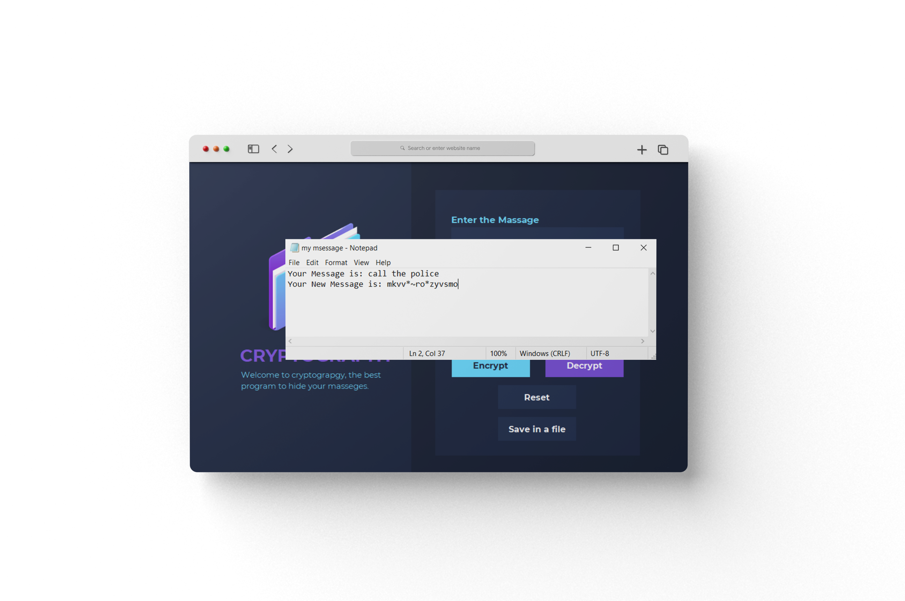
Save in a File Button

Slide 10
Accomplishments :
The most important achievement in the project is the team spirit. We all worked together very hard and honestly.
Also, among the milestones we were able to achieve on time for project delivery
What we learned?
We have learned many things in this project, but at the beginning we faced many problems because we are at the beginning of the learning process in python and we are not professionals
•We learned ways to program in a simple way and this saved us effort and time
For example:
We used try and exception and for loops :
it helps us not to repeat the process and its simplicity of us
also, how to fix any error and to let the program work correctly.

Slide 11
which objectives did you meet ?
We have achieved an impressive goal of developing the project in progress, while we learn something new in the class we go to implement it immediately.
which ones weren’t you able to meet in time ?
We faced a problem in the fourth algorithm, Baconian cipher decrypt didn’t work if the user enter any character except letters from a-z. That’s why we used try and except to inform the user with this condition.
Future work - will you continue?
We all decided to continue with the project as long as we learned something new and were constantly developing it.
Like the user can provide a new cipher algorithm in the program
And he can learn how this algorithms work
Also, we want to include Arabic Language too

Slide 12

CODE EXPLANATION
Now let's get into the code in details

